Slide 1
Library Database Management System in MySQL
Anwar Basha

Slide 2
About Me
B.E in Mechanical from RVS Technical Campus (Anna University, Chennai)
Having 5+ years of experience in Non-IT field.
Proficient in SQL, Python, and data analysis techniques.

Slide 3
Introduction
SQL (Structured Query Language) is a standard programming language used to manage and manipulate relational databases.
A DBMS (Database Management System) is software that enables the creation, management, and querying of databases, ensuring efficient data storage and retrieval.
In the context of a Library Database Management System, SQL is used to organize and manage the library's data, such as books, borrowers, and loan records, providing a systematic way to handle library operations and ensure data integrity.

Slide 4
Objective
The objective of this project is to design and implement a database by integrating data from various CSV files, ensuring proper data type assignment, and establishing relationships between tables using an Entity Relationship Diagram (ERD).
Additionally, the project aims to execute SQL queries to extract meaningful insights from the constructed database.

Slide 5
Overview of database
Book
Authors
Book Copies
Book Loans
Book ID
Author ID
Copies ID
Loans ID
Title
Book ID
Book ID
Book ID
Publisher Name
Author Name
Branch ID
Branch ID
No of Copies
Card No
Date Out
Due Date
Library Branch
Borrower
Publisher
Branch ID
Card No
Publisher Name
Branch Name
Borrower Name
Publisher Address
Branch Address
Borrower Address
Publisher Phone
Borrower Phone

Slide 6
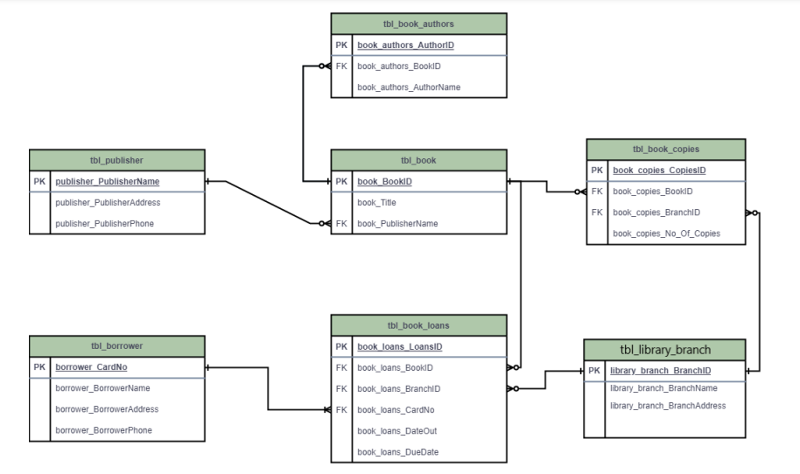
ERD (Entity-Relationship Diagram)

Slide 7
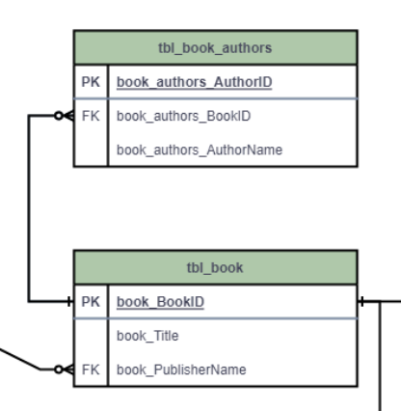
Column Name | Book ID
Primary Key Table | Book Authors
Foreign Key Table | Book
Types of Relationship | One to Many

Slide 8
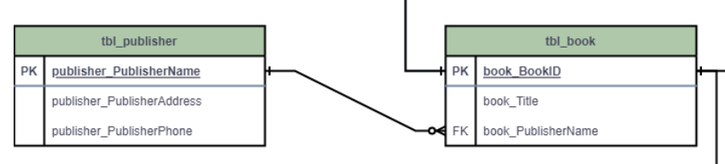
Column Name | Publisher Name
Primary Key Table | Publisher
Foreign Key Table | Book
Types of Relationship | One to Many

Slide 9
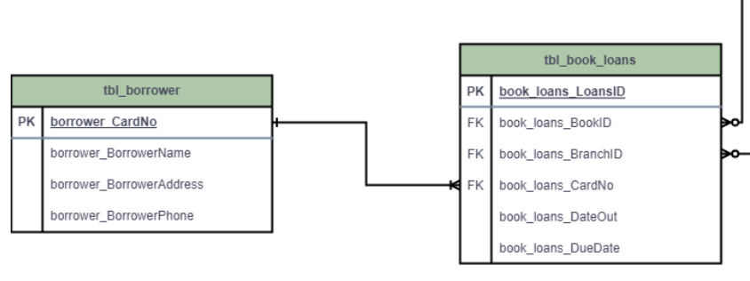
Column Name | Card No
Primary Key Table | Borrower
Foreign Key Table | Loans
Types of Relationship | One to Many

Slide 10
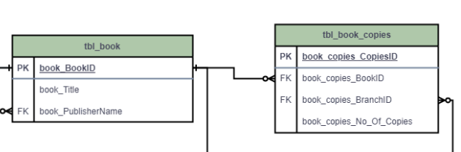
Column Name | Book ID
Primary Key Table | Book
Foreign Key Table | Book Copies
Types of Relationship | One to Many

Slide 11
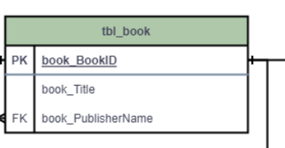
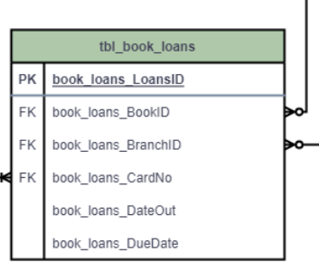
Column Name | Book ID
Primary Key Table | Book
Foreign Key Table | Book Loans
Types of Relationship | One to Many

Slide 12
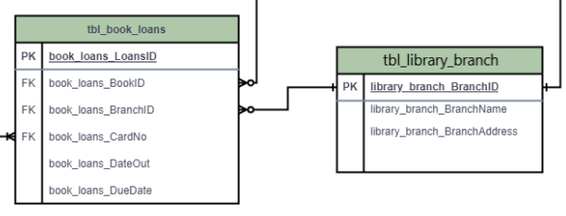
Column Name | Branch ID
Primary Key Table | Library Branch
Foreign Key Table | Branch ID
Types of Relationship | One to Many

Slide 13
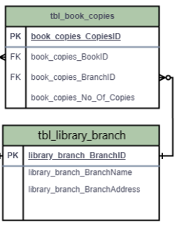
Column Name | Branch ID
Primary Key Table | Library Branch
Foreign Key Table | Book Copies
Types of Relationship | One to Many

Slide 14
SQL Queries Performed
To find the total number of copies of "The Lost Tribe" owned by the Sharpstown branch.
To retrieve the number of copies of "The Lost Tribe" for each library branch.
To identify borrowers who currently have no books checked out.
To get detailed information about books loaned out from Sharpstown branch due on 2/3/18.

Slide 15
SQL Queries Performed
To calculate the total number of books currently loaned out from each branch.
To find borrowers who have checked out more than five books, along with their contact details.
To find out how many copies of Stephen King’s books are owned by the Central branch.

Slide 16
Thank You

